Slide 1

DHRUV NARWARE
DOCKER INTERNALS
VIRTUALISATION, BUT SIMPLER
KOSS TASK ROUND

Slide 2
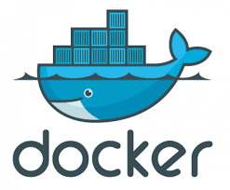
“IT RUNS ON MY MACHINE”
We face this issue many times on our machines, and not on other machine owing to many factors, like different versions of tools and packages.
DOCKER
Docker solves this issue, by allowing you to package your projects into unit called containers. It is like virtualisation, but easier and more efficient.

Slide 3
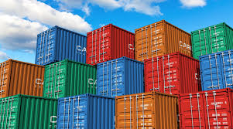

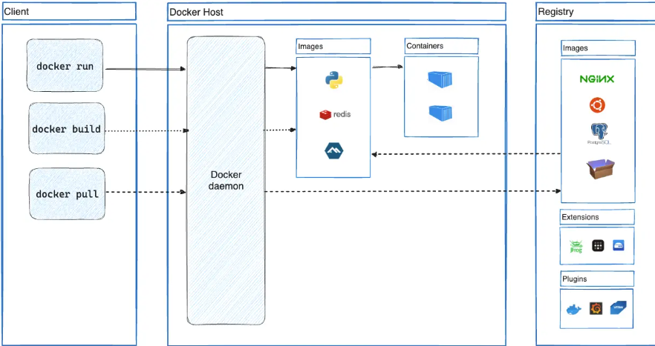
CONTAINERISATION
Containerization is the process of bundling an application's code, runtime, system tools, libraries, and settings into a single package (a container).
This package can then be run reliably on any infrastructure, ensuring the application behaves the same way regardless of the underlying environment.
A container is defined by its image as well as any configuration options you provide to it when you create or start it. When a container is removed, any changes to its state that aren't stored in persistent storage disappear
START
User runs docker pull
Docker daemon pulls image from registry
Docker daemon creates container
User runs docker pull
Container runs application
User manages container(stop start, remove)

Slide 4
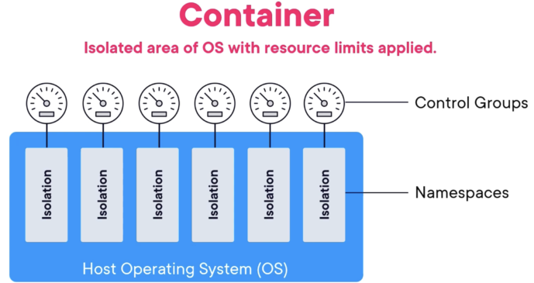


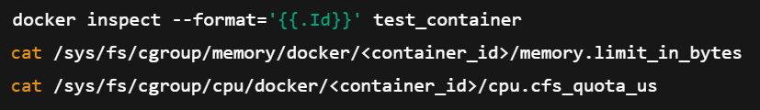
CGROUPS
Control groups are a Linux kernel feature that allows allocation of resources like CPU, Memory, Disk I/O, network.
When you start a Docker container, cgroups help enforce resource limits by:
Restricting CPU Usage: You can limit how much CPU a container can use by setting CPU shares, quotas, and periods.
Managing Memory Allocation: Prevents a container from using all available memory and causing the system to crash.
Controlling Disk I/O: Limits how fast a container can read/write data to disk to avoid slowing down other processes.
Network Bandwidth Control: Allocates network resources to ensure fair usage among multiple containers.
EXAMPLE
HOW TO USE
CGROUPS
FIND CONTAINER ID FIRST
LIMITS CPU USAGE TO 50%
LIMITS MEMORY SIZE TO 256 MB
CHECK CGROUP SETTINGS AND REPLACE <CONTAINER_ID> WITH ACTUAL CONTAINER ID

Slide 5
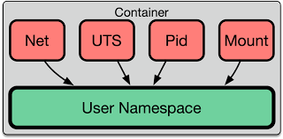

NAMESPACES
Namespaces in Docker are a key feature of Linux that provides isolation between different processes, ensuring that containers run independently.
Here are the main types of namespaces used in Docker:
1. PID Namespace (Process Isolation)
Each container gets its own process ID (PID) namespace.
A process inside a container cannot see or affect processes in another container or on the host.
2. Network Namespace (Network Isolation)
Each container gets its own network stack, including interfaces, IP addresses, routes, and firewall rules.
Containers can have separate or shared networks using Docker networking.
EXAMPLE
3. Mount Namespace (Filesystem Isolation)
Each container has its own separate filesystem view.
The container cannot access the host's filesystem unless explicitly mounted.
4. UTS Namespace (Host and Domain Name Isolation)
Containers can have their own hostname and domain name.
PID NAMESPACE(PROCESS NAMESPACE)-THE ABOVE COMMAND WILL SHOW ONLY PROCESSES RUNNING INSIDE THE CONTAINER.
BY UTILISING NAMESPACES, CONTAINER RUNTI MES CAN CREATE ISOLATED ENVIRONMENTS THAT APPEAR TO BE THEIR OWN PROCESSES, INDEPENDENT SYSTEMS, COMPLETE WITH THEIR OWN PROCESSES, NETWORK STACK, FILESYSTEM, AND MORE

Slide 6
THE
DOCKER
ECOSYSTEM

Slide 7

CONTAINERD
"Containerd" is an open-source, industry-standard container runtime that manages the lifecycle of containers, focusing on simplicity, robustness, and portability,
CONTAINERD IS A DAEMON PROCESS RESPONSIBLE FOR MANAGING THE LIFECYCLE OF CONTAINERS, INCLUDING TASKS LIKE IMAGE TRANSFER AND STORAGE, CONTAINER EXECUTION, AND SUPERVISION, AS WELL AS LOW-LEVEL STORAGE AND NETWORK ATTACHMENTS.
IT PROVIDES A LOW-LEVEL CONTAINER RUNTIME THAT IS USED BY HIGHER-LEVEL TOOLS LIKE DOCKER TO MANAGE CONTAINERS.
RUNC
A KEY COMPONENT OF CONTAINERD’S ROBUSTNESS IS ITS DEFAULT USE OF OPEN CONTAINER INITIATIVE (OCI)-COMPLIANT RUNTIMES. BY USING RUNTIMES SUCH AS RUNC (A LOWER-LEVEL CONTAINER RUNTIME), CONTAINERD ENSURES STANDARDIZATION AND INTEROPERABILITY IN CONTAINERIZED ENVIRONMENTS. IT ALSO EFFICIENTLY DEALS WITH CORE OPERATIONS IN THE CONTAINER LIFE CYCLE, INCLUDING CREATING, STARTING, AND STOPPING CONTAINERS.
RUNC IS THE LOW-LEVEL CONTAINER RUNTIME USED BY DOCKER AND CONTAINERD TO CREATE AND RUN CONTAINERS. IT FOLLOWS THE OCI (OPEN CONTAINER INITIATIVE) RUNTIME SPECIFICATION, MAKING IT THE FOUNDATION FOR CONTAINER EXECUTION.
WHEN YOU RUN A CONTAINER USING DOCKER, THE PROCESS GOES LIKE THIS:
DOCKER CLI (DOCKER RUN UBUNTU) SENDS A REQUEST TO THE DOCKER DAEMON.
DOCKER DAEMON COMMUNICATES WITH CONTAINERD (THE HIGH-LEVEL RUNTIME).
CONTAINERD CALLS RUNC, WHICH ACTUALLY CREATES AND STARTS THE CONTAINER USING LINUX NAMESPACES AND CGROUPS.
THE CONTAINERIZED PROCESS RUNS AS AN ISOLATED INSTANCE ON THE HOST.

Slide 8
DOCKER ENGINE
Key Components of DOCKER ENGINE
Docker Engine is the core component that allows you to build, run, and manage containers. It acts as the runtime that executes containerized applications on a host machine.
Docker Daemon (dockerd)
A background service that manages containers.
Listens for API requests from the Docker CLI and executes commands.
Docker CLI (docker)
The command-line tool to interact with Docker.
Sends commands (docker run, docker build, etc.) to the daemon.
Image & Storage System
Uses Docker images as blueprints to create containers.
Manages storage using copy-on-write layers.
RUNS AN NGINX CONTAINER IN DETACHED MODE (-D).
DOCKER COMPOSE
Docker Compose is a tool for defining and running multi-container Docker applications.
It uses YAML configuration file to define the services, and volumes required by an application and manages them as a single unit.
Docker Compose simplifies the process of orchestrating complex applications on a single host.

Slide 9
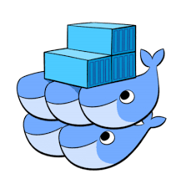
DOCKER SWARM
Docker Swarm is Docker’s built-in container orchestration tool, designed for managing a cluster of Docker nodes. It allows you to deploy and scale applications seamlessly across multiple machines.
DOCKER SWARM ARCHITECTURE
🔹 MANAGER NODES – CONTROL AND MANAGE THE CLUSTER.
🔹 WORKER NODES – RUN CONTAINERS BASED ON MANAGER INSTRUCTIONS.
🔹 SERVICES – DEFINE HOW A CONTAINER RUNS INSIDE THE SWARM.
🔹 TASKS – INDIVIDUAL INSTANCES OF A RUNNING CONTAINER.
DOCKER REGISTRY
A DOCKER REGISTRY IS A STORAGE SYSTEM WHERE DOCKER IMAGES ARE STORED, SHARED, AND DISTRIBUTED. IT ALLOWS DEVELOPERS TO PUSH, PULL, AND MANAGE CONTAINER IMAGES.
🔹 HOW DOCKER REGISTRY WORKS
1️⃣ PUSH AN IMAGE → DEVELOPERS UPLOAD IMAGES TO A REGISTRY.
2️⃣ STORE & MANAGE → THE REGISTRY STORES DIFFERENT VERSIONS OF IMAGES.
3️⃣ PULL AN IMAGE → DEVELOPERS OR SERVERS DOWNLOAD IMAGES WHEN NEEDED.
4️⃣ DEPLOY CONTAINERS → IMAGES ARE USED TO RUN CONTAINERS.
A PUBLIC REGISTRY, LIKE DOCKER HUB, ALLOWS ANYONE TO PULL CONTAINER IMAGES. IT IS USEFUL FOR SHARING OPEN-SOURCE SOFTWARE BUT LACKS ACCESS CONTROL AND SECURITY CUSTOMIZATION.
A PRIVATE REGISTRY, ON THE OTHER HAND, IS SELF-HOSTED OR CLOUD-BASED AND RESTRICTS ACCESS TO AUTHORIZED USERS. THIS ENSURES BETTER SECURITY, FASTER DEPLOYMENT FOR INTERNAL TEAMS, AND COMPLETE CONTROL OVER IMAGE STORAGE AND MANAGEMENT.

Slide 10

THANK YOU VERY MUCH!

